Slide 1

TRIPPR
Final Project

Slide 2
Our Team
Even Xu
Tanav Sharma
Bryan K
Keith McManamen
Juanita Camargo

Slide 3
TRIPPR Tell us about you so we tell you what’s your next stop!
In this presentation:
Process workflow
Front End - Input Looks
Front End 10 questions to the user
Quick Glance at the data processing
Back End / Data Processing High Level Process
ERD Overview
Front End - Output Looks
Requirements:
Database
Programing language
Visualizations
Front end
Machine learning model
Forms of analytics

Slide 4
Stage 1 | Front End | Step 1: User creates an account Step 2: User answers 10 questions about their preferences Step 3: User provides the location they will be at Example: If user goes to CN Tower + Niagara Falls + Hotel
Stage 2 | Back End | Check the Data Processing at a glance here
Stage 3 | Front End | Output 1: TRIPPR gives the User the Best Route to take along the Top 3 Best Recommendations around their location based on their interests. Example: if the user likes to be social and likes to go on adventures, the ML will recommend clubs and a hiking trail along the route Bonus: The User is asked to click on the most liked out of the 3 recommendations which goes back to our ML model to be fed so it learns

Slide 5
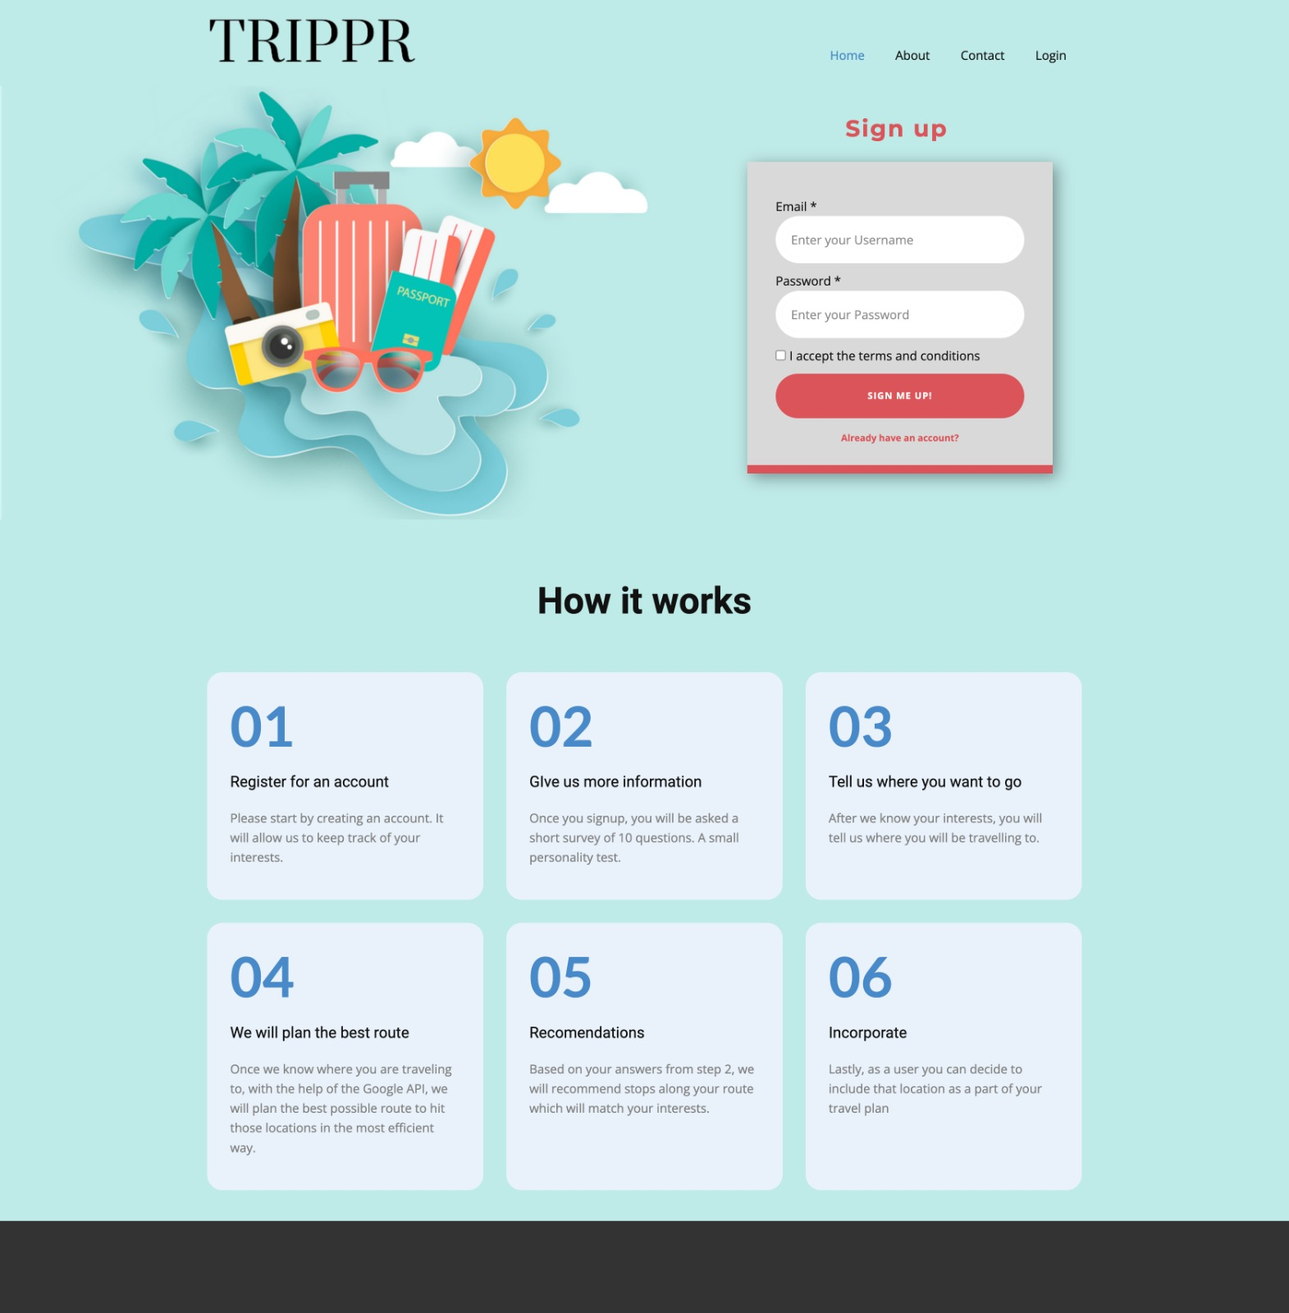
Front End – INPUT

Slide 6
Front End 10 questions for the User to answer
In a scale from 1 (less like you) to 5 (more like you) answer the following 10 questions:
Never miss the chance of trekking a peak at sunrise
A destination that has plenty of leisure and cultural activities options
A stay at an all-inclusive resort by the beach
Dancing has to be part of the getaway
I go on vacation but keep up my training even at an indoor pool
My home library is full of handy Travelling books
Eating is an experience I enjoy at any fine dining restaurant
A guided tour of the city is always part of my journey
I go away to get good rest and a spa is always a good idea
Never come back home without souvenirs

Slide 7
A quick glance of the data processing:
Data from:
Google
Trip Advisor
Use of Machine Learning (clustering to come up with the top 3 recommendations nearby)
Gmaps to draw the route, tableau to show what data is supporting the perfect road trip plan
JS and HTML for the front end and web development/design
Firebase DB for unstructured data

Slide 8
User Input
Database
User registration details
Loading and Cleaning Data
Google Reviews
Analysis
Average Rating Per Category
TripAdvisor Data
User 10 answers
User location
Categorizing Data
Clustering
Machine Learning
Predicting Recommendations with Kmean
ERD Prep
HTML
User Input
Tabular Data to JSON
HTML
User Output
User Output

Slide 9
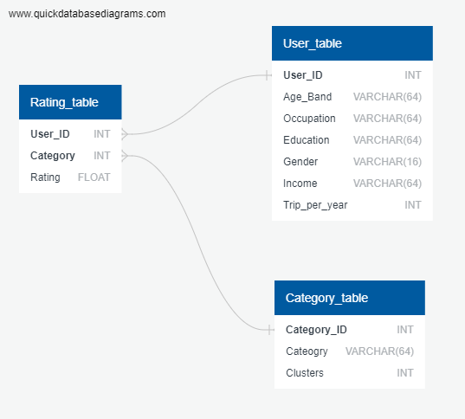
ERD

Slide 10
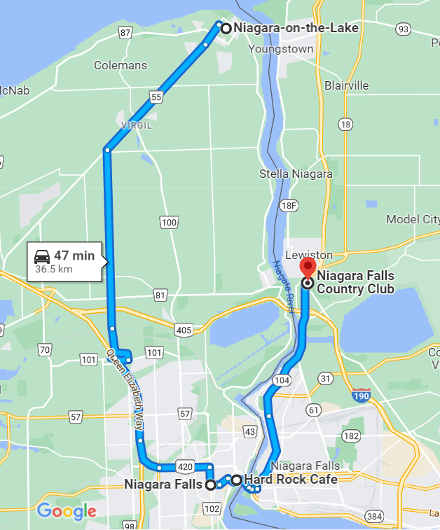



Front End – OUTPUT
Stop 1:
Make your way to great pictures at Niagara Falls
Stop
Grab an amazing Burger and Fries at Hard Rock Café
Stop
Wrap your day with a Golf Game at the Niagara Falls Country Club
1
2
3
3
2
1
Tell us which of the above you are more excited about by clicking on the number!
We hope you enjoyed TRIPPR!

Slide 11
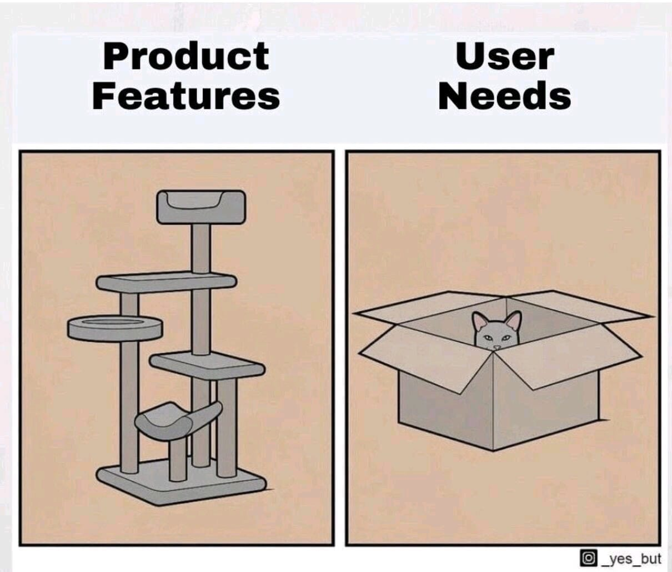
Our team likes meeting the user wishes

